Slide 1
From raw reads to variants
Anna Johansson
Uppsala, September 2019

Slide 2
Talk Overview
Concepts
Reference genome
Variants
Paired-end data
NGS Workflow
Quality control & Trimming
Alignment
Local realignment
PCR duplicates & removal
Base Quality Score Recalibration
Variant calling
VCF files
Joint genotyping & gVCF files
Annotation & Filtering
Notes:
During the course of this talk I hope to explain some core concepts around NGS data such as the basics surrounding what the reference genome, variants and paired-end data is. This will be background information for the main point which is to cover the main concepts of a typical best practice workflow, or as some people call it a “pipeline”, where we take the raw reads in fastq format all the way to variants. I will dive a little deeper into the output from variant calling, the VCFs or Variant Call Format, what joint genotyping is and the principal of annotating and filtering the variants.
As with anything there is more to know about each of these subjects and I encourage you to go deeper as needed.

Slide 3

Reference genome
Genome Reference Consortium
A mosaic nucleic acid sequence
...GTGCGTAGACTGCTAGATCGAAGA...
Notes:
The first concept we need to understand is what the reference genome is. It is a haploid nucleic acid sequence which represents a species.
HG19 was release in 2009 and is based on thirteen anonymous volunteers from Buffalo, NY.

Slide 4
Reference genome
Genome Reference Consortium
A mosaic nucleic acid sequence
...GTGCGTAGACTGCTAGATCGAAGA...
What changes between versions?
First version: 150,000 gaps
HG19: 250 gaps
Notes:
The first concept we need to understand is what the reference genome is. It is a haploid nucleic acid sequence which represents a species.
HG19 was release in 2009 and is based on thirteen anonymous volunteers from Buffalo, NY.
Roughly; the newer the version of the reference genome the fewer the gaps. Compare the first version of the human genome which had 150k gaps and hg19 which had 250. The latest human reference genome, HG38, was release 24th of December 2013. So what it all boils down to is that this is a genetic map of a species.

Slide 5
Variants
A position where sample sequence does not agree with reference genome sequence
Reference: ...GTGCGTAGACTGCTAGATCGAAGA...
Notes:
Keeping that in mind, what is a variant? A variant is a position where the samples sequence does not agree with the reference genome sequence. Here for example is 24 nucleotides from a reference genome.

Slide 6
Variants
A position where sample sequence does not agree with reference genome sequence
Reference: ...GTGCGTAGACTGCTAGATCGAAGA...
Sample: ...GTGCGTAGACTGATAGATCGAAGA...
Notes:
Keeping that in mind, what is a variant? A variant is a position where the samples sequence does not agree with the reference genome sequence. Here for example is 24 nucleotides from a reference genome.
When I then align the genomic sequence of a sample to the reference genome and compare we see that in one position where the reference sample is Cytosine we have Adenine. In this case this is a variant in that sample.

Slide 7


Variants
Population based variant projects
Notes:
Looking at the bigger picture of variants for multiple samples, such as whole populations we have population based variation projects such as the UK 10K and 1000Genomes project that map the variation of many humans giving the frequency of variants so that we can know if they are common or rare in a population.
The genetics of these samples coupled with the phenotypic traits of the donors make them a good resource for, for example, genome wide association studies.
If a single nucleotide variant, or polymorphism, exists to an appreciable degree in a population, eg > 1%, we usually refer to it as a SNP.

Slide 8
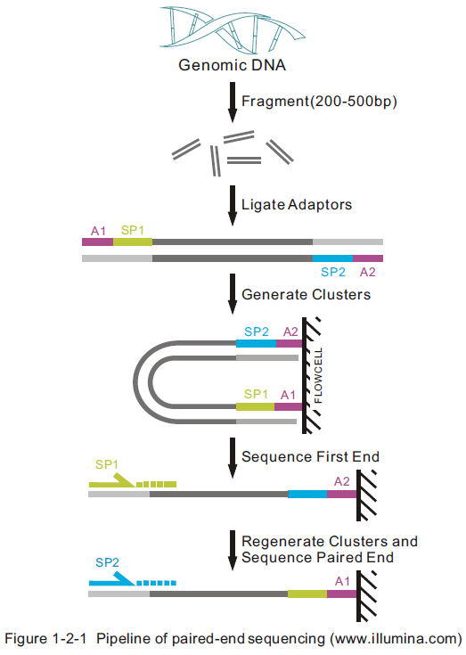
Paired-end sequencing
Notes:
**Olga already talks about this, try to get your lecture after hers.
The final important concept before we move on to the NGS workflow.
To describe our input data we need a brief refresher on what our data actually is. Paired end sequencing starts off similarly to other sequence protocols where the DNA is fragmented and adaptors are ligated to the ends of a fragment and are PCR amplified to generate clusters. The adaptors find complementary locations on a flowcell.
After this the reverse strands are washed off and the forward strands are sequenced. Then the clusters are regenerated and the reverse strands are sequenced.
DNA Fragmentation
Adaptors attached
PCR amplification
Attach to flowcell
Reverse flushed, forward sequenced
Clusters regenerated, forward flushed and reverse sequenced.

Slide 9
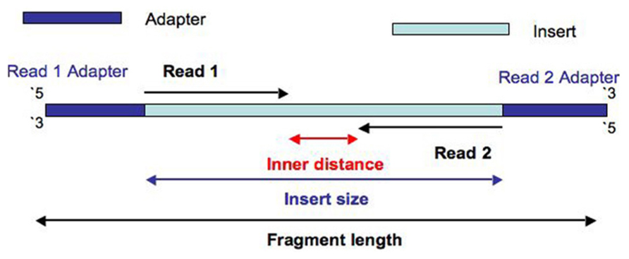
Paired-end data
Notes:
Here is a more clear picture of just a paired end read. We have the adapters flanking the fragment. The fragment length is the entire fragment, adapters and all, whereas the insert size contains the reads themselves and the distance between them. Since we knew the length of the insert this means that we can expect the inner distance between the pairs, something very convenient that we will get back to later.

Slide 10
Illumina sequencing
https://www.youtube.com/watch?v=fCd6B5HRaZ8

Slide 11
Paired-end data
The forward and reverse reads are stored in two fastq files.
ID_R1_001.fastq
ID_R2_001.fastq
@HISEQ:100:C3MG8ACXX:5:1101:1160:2197 1:N:0:ATCACG
CAGTTGCGATGAGAGCGTTGAGAAGTATAATAGGAGTTAAACTGAGTAACAGGATAAGAAATAGTGAGATATGGAAACGTTGTGGTCTGAAAGAAGATGT
+
B@CFFFFFHHHHHGJJJJJJJJJJJFHHIIIIJJJIHGIIJJJJIJIJIJJJJIIJJJJJIIEIHHIJHGHHHHHDFFFEDDDDDCDDDCDDDDDDDCDC
@HISEQ:100:C3MG8ACXX:5:1101:1160:2197 2:N:0:ATCACG
CTTCGTCCACTTTCATTATTCCTTTCATACATGCTCTCCGGTTTAGGGTACTCTTGACCTGGCCTTTTTTCAAGACGTCCCTGACTTGATCTTGAAACG
+
CCCFFFFFHHHHHJJJJIJJJJJJJJJJJJJJJJJJJJJJIJIJGIJHBGHHIIIJIJJJJJJJJIJJJHFFFFFFDDDDDDDDDDDDDDDEDCCDDDD
Notes:
Now the data has been delivered from the sequencing facility, we have two files containing the forward and reverse reads. These are stored in two fastq files. The two reads have identical metadata except for the information of which is the forward and reverse read.

Slide 12
Paired-end data
The forward and reverse reads are stored in two fastq files.
The order of pairs and naming is identical, except the designation of forward and reverse.
ID_R1_001.fastq
ID_R2_001.fastq
@HISEQ:100:C3MG8ACXX:5:1101:1160:2197 1:N:0:ATCACG
CAGTTGCGATGAGAGCGTTGAGAAGTATAATAGGAGTTAAACTGAGTAACAGGATAAGAAATAGTGAGATATGGAAACGTTGTGGTCTGAAAGAAGATGT
+
B@CFFFFFHHHHHGJJJJJJJJJJJFHHIIIIJJJIHGIIJJJJIJIJIJJJJIIJJJJJIIEIHHIJHGHHHHHDFFFEDDDDDCDDDCDDDDDDDCDC
@HISEQ:100:C3MG8ACXX:5:1101:1160:2197 2:N:0:ATCACG
CTTCGTCCACTTTCATTATTCCTTTCATACATGCTCTCCGGTTTAGGGTACTCTTGACCTGGCCTTTTTTCAAGACGTCCCTGACTTGATCTTGAAACG
+
CCCFFFFFHHHHHJJJJIJJJJJJJJJJJJJJJJJJJJJJIJIJGIJHBGHHIIIJIJJJJJJJJIJJJHFFFFFFDDDDDDDDDDDDDDDEDCCDDDD
Notes:
Now the data has been delivered from the sequencing facility, we have two files containing the forward and reverse reads. These are stored in two fastq files. The two reads have identical metadata except for the information of which is the forward and reverse read.
The R1 tag and the 1 here which signify that this file contains all the forward reads. Similarly the R2 file contains all the reverse read pairs.

Slide 13
NGS workflow
QC and trimming
Alignment
Local Realignment
Duplicate removal
Variant calling
BQSR
FASTQ files
SAM files
BAM files
VCF files
Notes:
Now that you understand the input data and some of the necessary concepts I will talk about a typical best practice bioinformatics workflow for NGS data.

Slide 14
NGS workflow
QC and trimming
Alignment
Local Realignment
Duplicate removal
Variant calling
BQSR
Notes:
And I will start with Quality control and Trimming of the reads delivered by the sequencing facility.

Slide 15
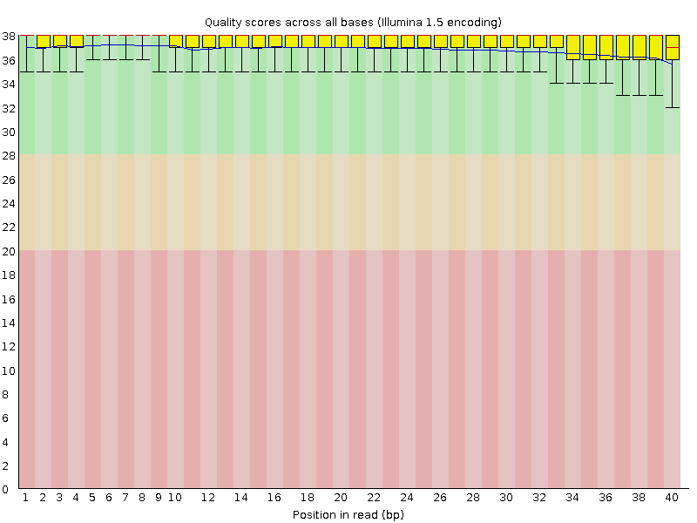
Quality control
module load FastQC
Bad qualities: Good qualities:
Notes:
One commonly used tool for quality control is FastQC which you can load using Uppmaxs module load system as shown here. If you have multiple samples a good tool developed out of NGI stockholm is MultiQC which concatenates and visualizes the qualities of multiple samples.
But first, lets just talk abit about some of the usual suspects when quality controlling the data.
(The qualities should have been discussed earlier during Martins lectures)
Here we see two examples of the individual base qualities across the read length. A usual cutoff for quality score is around 20, today with improving techniques you will find people set it even higher, at around 30. It is a balancing act of how much data you can afford to throw away based on quality and how low quality you dare keep since it may give errors later on.
Q20 means about 99% chance that the base in that position is correct.
Q=-10*log10(P)
P=Base call accuracy

Slide 16
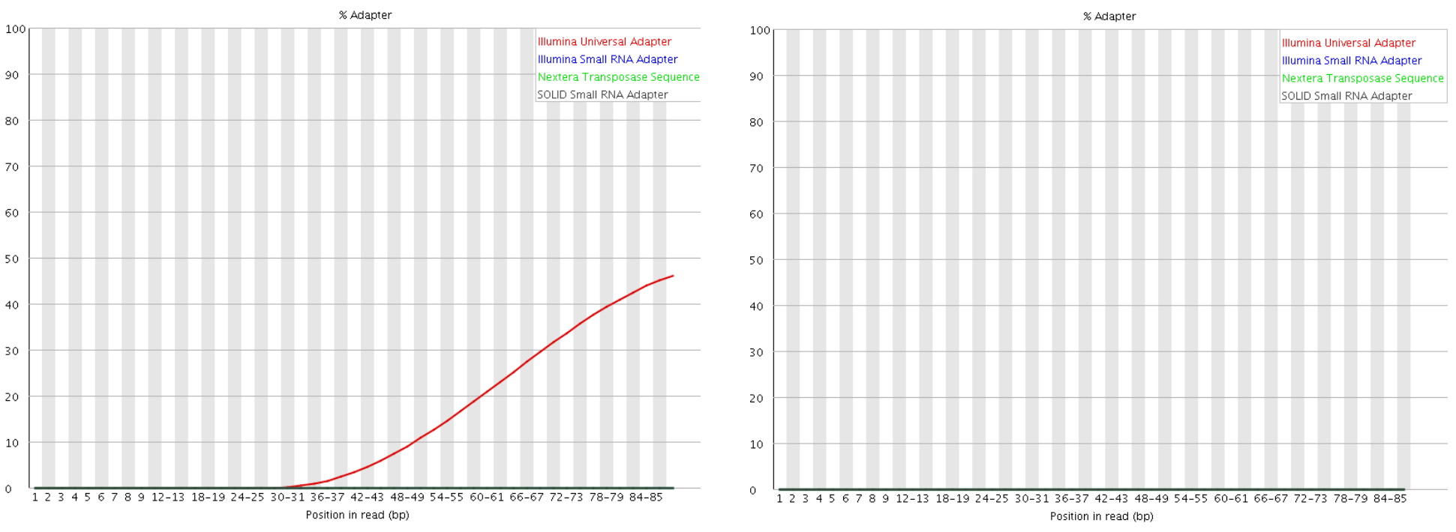
Quality control
module load FastQC
Adapters present: Adapters Absent:
Notes:
The adapters used for sequencing should be removed before aligning for greater alignment efficiency, since the reference sequence doesn’t have adapter sequences all over the place =).
To the left we see once again the position on the read with the red line showing that we have illumina universal adapter present to a certain percentage. To the right we see trimmed reads where no adapters are detected.
There are other quality metrics specific to different kinds of data such as GC biases and sequence content so be sure to read up on quality controlling your specific dataset. There are usually some quality metrics delivered by the sequencing facility as well.

Slide 17
Trimming
module load cutadapt / TrimGalore / trimmomatic
Remove bad quality reads
Remove adapters
Notes:
So how do we solve the quality issues with our data? In the cases where they are solveable of course… with Trimming!
There are a couple of different tools when trimming reads, some common ones are cutadapt, trimGalore and trimmomatic.
Their main purpose is to trim adapters which, as the picture illustrates, can be attached to reads in several different ways. For example if the adapter is short and the read is long the adapter can be contained within the read. We can also have a situation where the adapter is degraded and only partially present at the end of a read. In some cases we know that the adapter is anchored, that is to say that it is not degraded and it is expected to not be within the read. Knowing about the kind of adapter helps pick a suitable trimming method to get high quality reads.
As discussed earlier trimming is usually a stage where you remove bad quality reads as well.

Slide 18
NGS workflow
QC and trimming
Alignment
Local Realignment
Duplicate removal
Variant calling
BQSR
Notes:
Now we have quality controlled our reads and performed the necessary trimming. This means that we took our original forward and reverse fastq files and created new ones, trimmed to our specifications to remove adapters and only keep good quality reads.
The next step in the workflow is Aligning the reads.

Slide 19
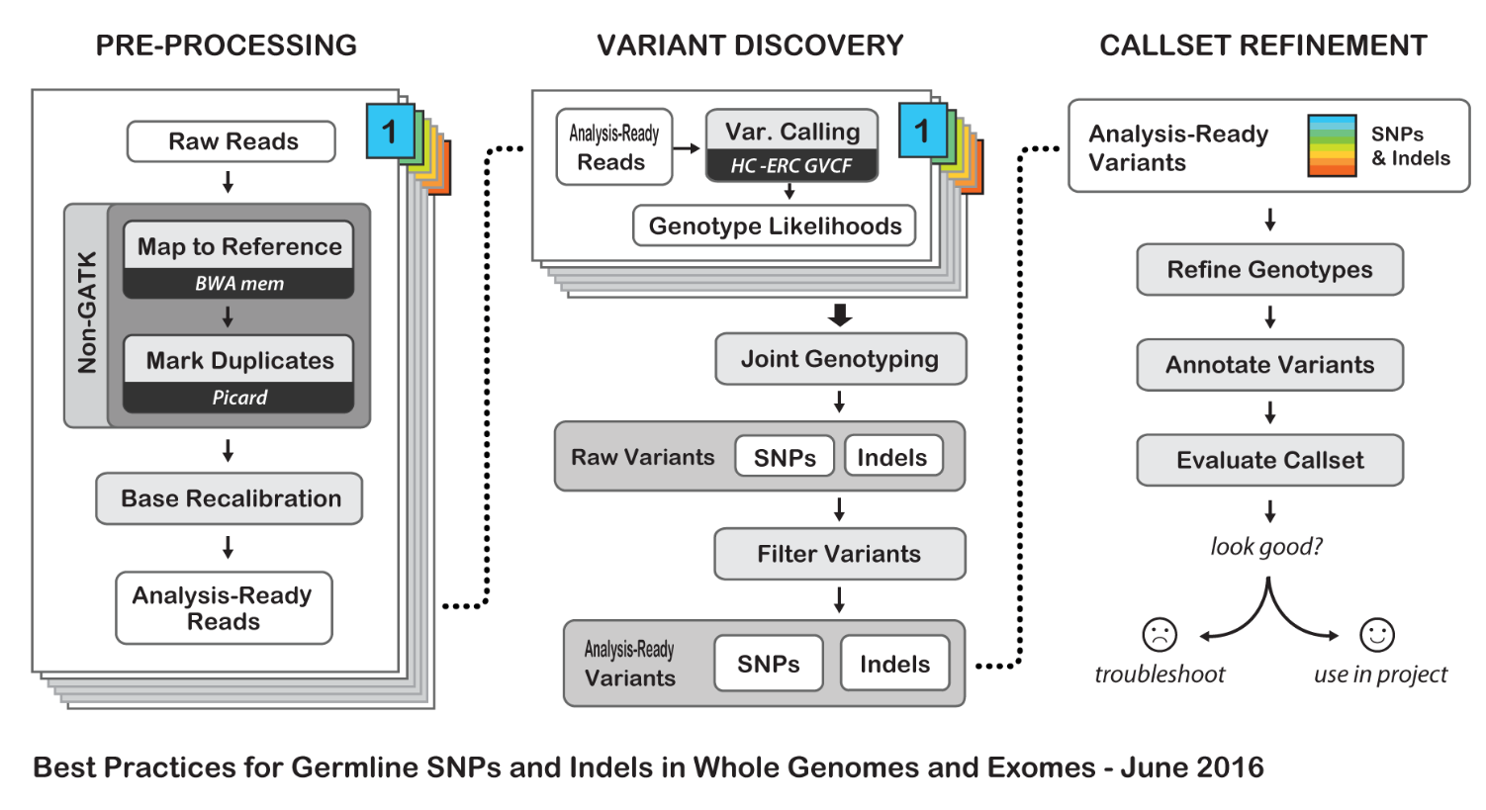
GATK Best Practices
https://software.broadinstitute.org/gatk/best-practices/
Notes:
But before we dive in to alignment I will mention that this is where the recommendations of the Broad institute best practices start. A guide that they have maintained pretty-well for several years where they recommend tools and setting to use for a standard analysis. I recommend that someone setting up a bioinformatics workflow or wanting to compare what has been done with their data and what is currently considered best practice be intimately aware of these recommendations.
//A recent change has been made where they no longer recommend indel realignment, something I will talk about shortly, as it is performed on the fly at the variant calling stage. But I will get back to that. The takehome message here is that I want you to know that this resource exists as it is definitely something you should be looking at when running such a pipeline.

Slide 20
Alignment
module load bwa
Read TCGATCC
Reference GACCTCATCGATCCCACTG
Notes:
Alignment.
The most commonly used aligner for NGS data at the moment is BWA, or the Burrows-Wheeler Aligner, where Burrows Wheeler transform is used for patternmatching.
What we are trying to do in its simplest form is take one of our reads and fit it to its position on the reference genome. So here we have a read from our sample and the reference genome.

Slide 21
Alignment
module load bwa
Read TCGATCC
Reference GACCTCATCGATCCCACTG
Read TCGATCC
Reference GACCTCATCGATCCCACTG
Notes:
And here we have found the position where it matches the reference. And then do this for every read.

Slide 22
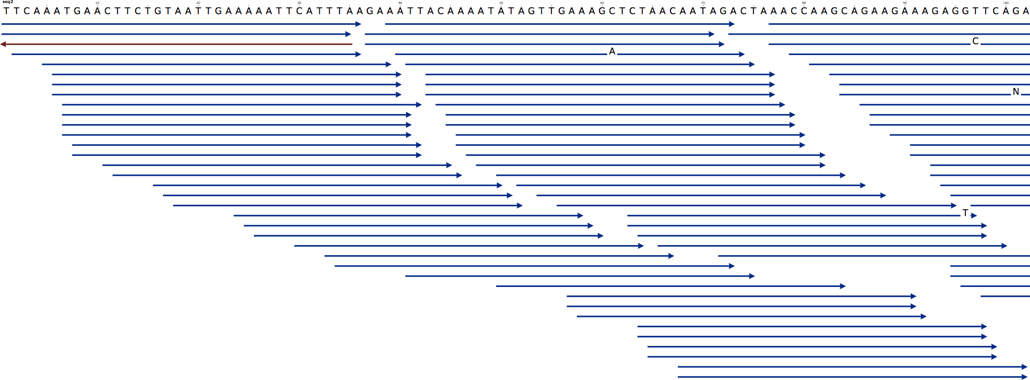
Alignment
module load bwa
Notes:
But of course we didn’t have just one read. Here we have a picture with the reference genome at the top and a collection of reads aligned to it. If you have heard of the “coverage” of your sample before this is what is meant.

Slide 23
Alignment
module load bwa
Coverage
Notes:
But of course we didn’t have just one read. Here we have a picture with the reference genome at the top and a collection of reads aligned to it. If you have heard of the “coverage” of your sample before this is what is meant.
The coverage is the number of reads aligned to a position. The average coverage of the sample then is the average number of reads covering a position over each genomic position. For example….

Slide 24
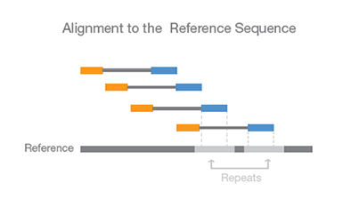
Paired-end data & Alignment
The known distance between paired reads allows improved mapping over repeat regions
Notes:
A brief interlude; Remember how I spoke earlier about paired end data? Now that you know what alignment is I can explain that one of the strengths of paired end data is that since the distance between the paired reads is known we can infer the position of the other read in repeat regions. After all once one read has mapped we know the approximate position of its pair.
Here is an illustration of this where we have two repeat regions and the blue read could easily map to either one but we know which one it maps to because of the position of its orange pair.
This property is also helpful for finding SVs.

Slide 25
Output from mapping - Sam format
HEADER SECTION
@HD VN:1.0 SO:coordinate
@SQ SN:1 LN:249250621 AS:NCBI37 UR:file:/data/local/ref/GATK/human_g1k_v37.fasta M5:1b22b98cdeb4a9304cb5d48026a85128
@SQ SN:2 LN:243199373 AS:NCBI37 UR:file:/data/local/ref/GATK/human_g1k_v37.fasta M5:a0d9851da00400dec1098a9255ac712e
@SQ SN:3 LN:198022430 AS:NCBI37 UR:file:/data/local/ref/GATK/human_g1k_v37.fasta M5:fdfd811849cc2fadebc929bb925902e5
@RG ID:UM0098:1 PL:ILLUMINA PU:HWUSI-EAS1707-615LHAAXX-L001 LB:80 DT:2010-05-05T20:00:00-0400 SM:SD37743 CN:UMCORE
@RG ID:UM0098:2 PL:ILLUMINA PU:HWUSI-EAS1707-615LHAAXX-L002 LB:80 DT:2010-05-05T20:00:00-0400 SM:SD37743 CN:UMCORE
@PG ID:bwa VN:0.5.4
ALIGNMENT SECTION
8_96_444_1622 73 scaffold00005 155754 255 54M * 0 0 ATGTAAAGTATTTCCATGGTACACAGCTTGGTCGTAATGTGATTGCTGAGCCAG C@B5)5CBBCCBCCCBC@@7C>CBCCBCCC;57)8(@B@B>ABBCBC7BCC=> NM:i:0
8_80_1315_464 81 scaffold00005 155760 255 54M = 154948 0 AGTACCTCCCTGGTACACAGCTTGGTAAAAATGTGATTGCTGAGCCAGACCTTC B?@?BA=>@>>7;ABA?BB@BAA;@BBBBBBAABABBBCABAB?BABA?BBBAB NM:i:0
8_17_1222_1577 73 scaffold00005 155783 255 40M1116N10M * 0 0 GGTAAAAATGTGATTGCTGAGCCAGACCTTCATCATGCAGTGAGAGACGC BB@BA??>CCBA2AAABBBBBBB8A3@BABA;@A:>B=,;@B=A:BAAAA NM:i:0 XS:A:+ NS:i:0
8_43_1211_347 73 scaffold00005 155800 255 23M1116N27M * 0 0 TGAGCCAGACCTTCATCATGCAGTGAGAGACGCAAACATGCTGGTATTTG #>8<=<@6/:@9';@7A@@BAAA@BABBBABBB@=<A@BBBBBBBBCCBB NM:i:2 XS:A:+ NS:i:0
8_32_1091_284 161 scaffold00005 156946 255 54M = 157071 0 CGCAAACATGCTGGTAGCTGTGACACCACATCAACAGCTTGACTATGTTTGTAA BBBBB@AABACBCA8BBBBBABBBB@BBBBBBA@BBBBBBBBBA@:B@AA@=@@ NM:i:0
Start position
Quality
Sequence
Read name
Notes:
QNAME: the name of the read.
FLAG: a bitwise number describing information about the read such as mapped/unmapped read, pairing, etc.
RNAME: the reference sequence name. The value of this field is * for unmapped reads.
POS: the left most mapping position of the first matching base. It is set to zero for unmapped reads.
MAPQ: a number to indicate the mapping quality.
CIGAR: a string describing how the read aligns with the reference. It consists of one or more components. Each component comprises an operator and the number of bases which the operator applies to. Operators are: MIDNSHP=X. The following table gives an overview of these operators
MNAME: the name of the mate strand, if it is a paired read. ‘=’ means that the name is the same as RNAME.
MPOS: a number indicating the left most mapping position of the mate.
TLEN: a number set to 0 for single-segment. For paired-segments it is calculated as the number of bases from the left most mapped base to the right most mapped base.
SEQ: the read sequence as the reference. If not ‘*’ then the length of the sequence must be equal the sum of lengths of M/I/S/=/X operations in the CIGAR string.
QUAL: the read quality, same as the quality string in a fastaq format.

Slide 26
Read groups
Link information of sample id, library prep, flowcell and sequencing runs to fastq file.
Good for error tracking!
Detailed description in tutorial or https://gatkforums.broadinstitute.org/gatk/discussion/6472/read-groups
RGID = Read group identifier usually derived from the combination of the sample id and run id
RGLB = Library prep identifier
RGPL = Platform (for us ILLUMINA)
RGPU = Run identifier usually barcode of flowcell
RGSM = Sample name

Slide 27
Convert to Bam
Bam file is a binary representation of the Sam file

Slide 28
NGS workflow
QC and trimming
Alignment
Local Realignment
Duplicate removal
Variant calling
BQSR
Notes:
Quality control of our reads is complete, additionally we have taken our forward and reverse reads and have aligned them to a reference genome. The next step is a local realignment of the reads.

Slide 29
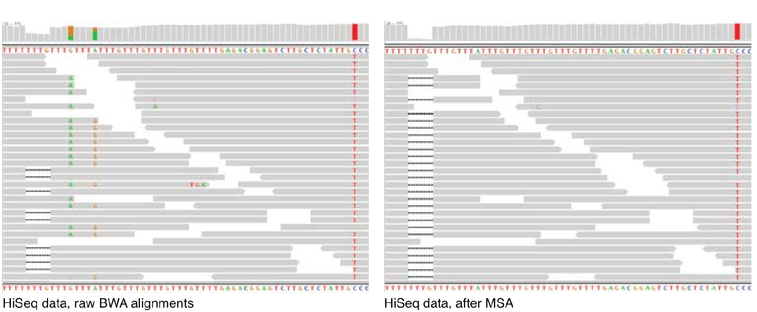
Local realignment
Problem: Reads are mapped one read at a time, this sometimes leads to single variants being split into multiple variants
Solution: Realign such a region taking all reads into account
Notes:
Local realignment is performed because of the way mapping is performed. Every read is mapped individually, this means that one read is naïve of the other reads in its position. This can lead to, doesnt have to happen often, but can lead to a single variant being split into multiple variants.
For example here on the left we have some T repeats where we get two variants A and G that, if just shifted abit to the right, are not two variants anymore. When we take all reads into account during local realignment it turns out the most likely explanation for this region is a deletion rather than a deletion and two variants.
From Broad on RTC: “The local realignment process is designed to consume one or more BAM files and to locally realign reads such that the number of mismatching bases is minimized across all the reads. In general, a large percent of regions requiring local realignment are due to the presence of an insertion or deletion (indels) in the individual's genome with respect to the reference genome. Such alignment artifacts result in many bases mismatching the reference near the misalignment, which are easily mistaken as SNPs. Moreover, since read mapping algorithms operate on each read independently, it is impossible to place reads on the reference genome such that mismatches are minimized across all reads. Consequently, even when some reads are correctly mapped with indels, reads covering the indel near just the start or end of the read are often incorrectly mapped with respect the true indel, also requiring realignment. Local realignment serves to transform regions with misalignments due to indels into clean reads containing a consensus indel suitable for standard variant discovery approaches.
Note that indel realignment is no longer necessary for variant discovery if you plan to use a variant caller that performs a haplotype assembly step, such as HaplotypeCaller or MuTect2. However it is still required when using legacy callers such as UnifiedGenotyper or the original MuTect.
There are 2 steps to the realignment process:
Determining (small) suspicious intervals which are likely in need of realignment (RealignerTargetCreator)
Running the realigner over those intervals (see the IndelRealigner tool)"

Slide 30
Local realignment
module load GATK
Genome Analysis ToolKit
RealignerTargetCreator
IndelRealigner
Local realignment, still needed?
HaplotypeCaller (HC)
Mutect2
Notes:
To perform local realignment we use BROADS GATK, or genome analysis toolkit, which is available on UPPMAX via the module load system. First the tool RealignerTargetCreator, as its name strongly implies, parses your aligned reads and identifies targets where realignment might be necessary. Then the tool indelrealigner is run, taking these targets as input, and performs the actual realignment.
Somewhat of a sidenote here is that the commonly used haplotypecaller, which is used for variant calling, performs local realignment on the fly. However, since most other variant callers to my knowledge do not have this feature and there is an intrinsic value in understanding what it is checking for I will explain this step anyway. I just thought you should know. I also mention mutect2 here which is a tool for tumor/normal variant calling, a lecture in and of itself, which also performs local realignment on the fly.

Slide 31
NGS workflow
QC and trimming
Alignment
Local Realignment
Duplicate removal
Variant calling
BQSR
Notes:
Now we have checked the quality of our reads, we have trimmed them accordingly and removed adapters, we have aligned them to a reference genome and we have corrected for issues that may have arisen during alignment by using all the aligned information for positions to clear up mistakes.
The next step in our workflow is removing duplicates from the data.

Slide 32
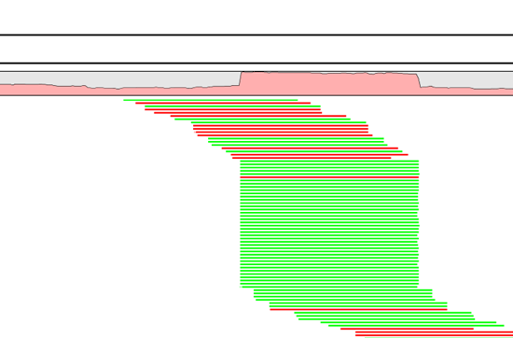
PCR duplicates & removal
module load picard
Occur during library preparation
Don’t add unique information
Optical duplicates
Notes:
One tool for this is picards MarkDuplicates.
Occur PCR
Copies same fragment goto different flowcells
High library complexity is good
Don’t add information
Optical duplicates
Less talked about
One flowcell cluster
Incorrectly identified on several cells
Amplicon
Duplicates typically arise during PCR amplification of the fragments with adapters. We are intentionally creating multiple copies of each original genomic DNA molecule so that you have enough of them. The PCR duplicates occur when two copies of the same original molecule get onto different areas of the flowcell. A greater amount of starting material, often termed as having a high complexity library, is a good indicator of not having a big problem with duplicates.
And duplicates don’t give any additional information, as you can see here, what we want is reads slightly off from eachother, so we know that they are adding new information. You can also choose to just mark the duplicates rather than remove them entirely as many variant callers can ignore reads marked as duplicates. This gives you the option later to perform variant calling with and without duplicates and compare the results.
Finally, during some kinds of sequencing, such as amplicon sequencing, you tend to recommend not removing duplicates as there will be many duplicates by design. So keep that in mind.
“optical duplicates are sequences from one flow cell cluster, that are (incorrectly) identified by software to be from multiple adjacent clusters. ”

Slide 33
NGS workflow
QC and trimming
Alignment
Local Realignment
Duplicate removal
Variant calling
BQSR
Notes:
Now that we have removed or marked our duplicates it is time to recalibrate our data.

Slide 34
Base Quality Score Recalibration
module load GATK
Identifies and corrects systematic (non-random) technical errors made by the sequencer when estimating the quality score of each base call
Correcting for over-/Underestimation of quality scores
Helps fight false positive variant calls
Rescues false negatives variant calls
Some errors can be due to the physics or chemistry of the sequencing reaction, some to manufacturing flaws in the equipment
Errors are identified over several covariates, mainly related to sequence context, position in read or machine cycle
Notes:
Base Quality Score Recalibration basically detects systematic errors made by the sequencer when it estimates the quality score of each base call, which is basically how confident the machine was that the called base is correct.
Some of these errors are due to the physics or the chemistry of how the sequencing reaction works, and some can be due to manufacturing flaws in the equipment.
The tool checks the covariation between Reported quality score, the position within the read and the preceding and current nucleotide observed by the sequencing machine to find non-random discrepancies that lead to the score being adjusted.
These systematic technical errors, leading to over- or under-estimated base quality scores in the data.

Slide 35
NGS workflow
QC and trimming
Alignment
Local Realignment
Duplicate removal
Variant calling
BQSR
Notes:
Finally, now that we have pre-processed our data as best as we know how we feel confident to try to identify our variants.

Slide 36
Variant calling
Reference: ...GTGCGTAGACTGCTAGATCGAAGA...
Sample: ...GTGCGTAGACTGATAGATCGAAGA...
Notes:
Lets briefly revisit our simplest form of what a variant was from the start of the lecture. There we saw the variant as a base position where the sample does not match the reference. Now lets make it more real by adding some more reads which have aligned to this position.

Slide 37
Variant calling
Reference: ...GTGCGTAGACTGCTAGATCGAAGA...
Sample: ...GTGCGTAGACTGATAGATCGAAGA...
...GTGCGTAGACTGATAGATCGAAGA...
...GTGCGTAGACTGCTAGATCGAAGA...
...GTGCGTAGACTGCTAGATCGAAGA...
...GTGCGTAGACTGATAGATCGAAGA...
...GTGCGTAGACTGATAGATCGAAGA...
...GTGCGTAGACTGCTAGATCGAAGA...
...GTGCGTAGACTGATAGATCGAAGA...
...GTGCGTAGACTGCTAGATCGAAGA...
...GTGCGTAGACTGATAGATCGAAGA...
Notes:
Variant calling is looking for positions where some number of reads disagree with the reference genome. Here for example the reference sample says the position should be a C whereas 6 of the reads say it is an A in the sample. This is also what is meant with the allelic frequency of a variant, out of 10 reads 6 are variant therefore the allelic frequency of A is 60%.

Slide 38

Variant calling
Reference: ...GTGCGTAGACTGCTAGATCGAAGA...
Sample: ...GTGCGTAGACTGATAGATCGAAGA...
...GTGCGTAGACTGATAGATCGAAGA...
...GTGCGTAGACTGCTAGATCGAAGA...
...GTGCGTAGACTGCTAGATCGAAGA...
...GTGCGTAGACTGATAGATCGAAGA...
...GTGCGTAGACTGATAGATCGAAGA...
...GTGCGTAGACTGCTAGATCGAAGA...
...GTGCGTAGACTGATAGATCGAAGA...
...GTGCGTAGACTGCTAGATCGAAGA...
...GTGCGTAGACTGATAGATCGAAGA...
$$\frac{\#Variants in a position}{\#Reads in a position }=A variants allele frequency$$
Notes:
Variant calling is looking for positions where some number of reads disagree with the reference genome. Here for example the reference sample says the position should be a C whereas 6 of the reads say it is an A in the sample. This is also what is meant with the allelic frequency of a variant, out of 10 reads 6 are variant therefore the allelic frequency of A is 60%.
Note that this is not the same as population based allele frequencies that measures the relative frequency of an allele in a population.

Slide 39
Variant Calling HaplotypeCaller
Notes:
As an example of how variants are called we can look at the GATK HaplotypeCaller which is perhaps the most popular variant caller at the moment.
It works by identifying so called “active regions” which means regions showing signs of variation, much in the same way as RTC. It then discards the mapping information for that region completely and reassembles plausible haplotypes for the region. This is something you may recognize as pretty much what the local realignment does which is why for this specific variant caller local realignment in the preprocessing is superfluous.
In the next step it determines the per-read likelihoods against each identified haplotype, so “how likely is this read to fit this haplotype?”, and using these likelihoods from all of the reads covering a potentially variant site the most likely genotype is assigned.

Slide 40
NGS workflow
QC and trimming
Alignment
Local Realignment
Duplicate removal
Variant calling
BQSR
Notes:
Now we have completed the NGS workflow going from inspecting the quality of the reads, trimming the adapters, aligning the reads, realigning the reads in variation active regions, removing or marking duplicates, recalibrating the base quality scores and finally calling variants.
Now lets look at the output of the variant calling.

Slide 41
VCF Files
##fileformat=VCFv4.0 ##fileDate=20090805
##source=myImputationProgramV3.1
##reference=1000GenomesPilot-NCBI36
##phasing=partial
##INFO=<ID=NS,Number=1,Type=Integer,Description="Number of Samples With Data"> ##INFO=<ID=DP,Number=1,Type=Integer,Description="Total Depth"> ##INFO=<ID=AF,Number=.,Type=Float,Description="Allele Frequency"> ##INFO=<ID=AA,Number=1,Type=String,Description="Ancestral Allele"> ##INFO=<ID=DB,Number=0,Type=Flag,Description="dbSNP membership, build 129"> ##INFO=<ID=H2,Number=0,Type=Flag,Description="HapMap2 membership"> ##FILTER=<ID=q10,Description="Quality below 10">
##FILTER=<ID=s50,Description="Less than 50% of samples have data"> ##FORMAT=<ID=GT,Number=1,Type=String,Description="Genotype"> ##FORMAT=<ID=GQ,Number=1,Type=Integer,Description="Genotype Quality"> ##FORMAT=<ID=DP,Number=1,Type=Integer,Description="Read Depth"> ##FORMAT=<ID=HQ,Number=2,Type=Integer,Description="Haplotype Quality">
#CHROM POS ID REF ALT QUAL FILTER INFO FORMAT NA00001 NA00002 NA00003
20 14370 rs6054257 G A 29 PASS NS=3;DP=14;AF=0.5;DB;H2 GT:GQ:DP:HQ 0|0:48:1:51,51 1|0:48:8:51,51 1/1:43:5:.,.
20 17330 . T A 3 q10 NS=3;DP=11;AF=0.017 GT:GQ:DP:HQ 0|0:49:3:58,50 0|1:3:5:65,3 0/0:41:3
20 1110696 rs6040355 A G,T 67 PASS NS=2;DP=10;AF=0.333,0.667;AA=T;DB GT:GQ:DP:HQ 1|2:21:6:23,27 2|1:2:0:18,2 2/2:35:4
Notes:
VCF files, or variant call format files, are divided into two main parts. The top, or head, of the file, with hashtag prefixed lines, is a descriptive part explaining the information given for each variant and each sample, if multiple samples exists. It also gives the date and some information from the variant caller used.
Below this are the actual variants, one line per variant.
Now lets look at each part alittle closer.
(Update later to latest vcf format)

Slide 42
VCF Files
##fileformat=VCFv4.0 ##fileDate=20090805
##source=myImputationProgramV3.1
##reference=1000GenomesPilot-NCBI36
##phasing=partial
##INFO=<ID=NS,Number=1,Type=Integer,Description="Number of Samples With Data"> ##INFO=<ID=DP,Number=1,Type=Integer,Description="Total Depth"> ##INFO=<ID=AF,Number=.,Type=Float,Description="Allele Frequency"> ##INFO=<ID=AA,Number=1,Type=String,Description="Ancestral Allele"> ##INFO=<ID=DB,Number=0,Type=Flag,Description="dbSNP membership, build 129"> ##INFO=<ID=H2,Number=0,Type=Flag,Description="HapMap2 membership"> ##FILTER=<ID=q10,Description="Quality below 10">
##FILTER=<ID=s50,Description="Less than 50% of samples have data"> ##FORMAT=<ID=GT,Number=1,Type=String,Description="Genotype"> ##FORMAT=<ID=GQ,Number=1,Type=Integer,Description="Genotype Quality"> ##FORMAT=<ID=DP,Number=1,Type=Integer,Description="Read Depth"> ##FORMAT=<ID=HQ,Number=2,Type=Integer,Description="Haplotype Quality">
#CHROM POS ID REF ALT QUAL FILTER INFO FORMAT NA00001 NA00002 NA00003
20 14370 rs6054257 G A 29 PASS NS=3;DP=14;AF=0.5;DB;H2 GT:GQ:DP:HQ 0|0:48:1:51,51 1|0:48:8:51,51 1/1:43:5:.,.
20 17330 . T A 3 q10 NS=3;DP=11;AF=0.017 GT:GQ:DP:HQ 0|0:49:3:58,50 0|1:3:5:65,3 0/0:41:3
20 1110696 rs6040355 A G,T 67 PASS NS=2;DP=10;AF=0.333,0.667;AA=T;DB GT:GQ:DP:HQ 1|2:21:6:23,27 2|1:2:0:18,2 2/2:35:4
Notes:
In the very top we see the fileformat, in this case VCFv4.0, I think the newest one is 4.2, the date the file was created, the program used to generate the vcf and the reference genome used. However this information can vary depending on where the program came from.

Slide 43
VCF Files
##fileformat=VCFv4.0 ##fileDate=20090805
##source=myImputationProgramV3.1
##reference=1000GenomesPilot-NCBI36
##phasing=partial
##INFO=<ID=NS,Number=1,Type=Integer,Description="Number of Samples With Data"> ##INFO=<ID=DP,Number=1,Type=Integer,Description="Total Depth"> ##INFO=<ID=AF,Number=.,Type=Float,Description="Allele Frequency"> ##INFO=<ID=AA,Number=1,Type=String,Description="Ancestral Allele"> ##INFO=<ID=DB,Number=0,Type=Flag,Description="dbSNP membership, build 129"> ##INFO=<ID=H2,Number=0,Type=Flag,Description="HapMap2 membership"> ##FILTER=<ID=q10,Description="Quality below 10">
##FILTER=<ID=s50,Description="Less than 50% of samples have data"> ##FORMAT=<ID=GT,Number=1,Type=String,Description="Genotype"> ##FORMAT=<ID=GQ,Number=1,Type=Integer,Description="Genotype Quality"> ##FORMAT=<ID=DP,Number=1,Type=Integer,Description="Read Depth"> ##FORMAT=<ID=HQ,Number=2,Type=Integer,Description="Haplotype Quality">
#CHROM POS ID REF ALT QUAL FILTER INFO FORMAT NA00001 NA00002 NA00003
20 14370 rs6054257 G A 29 PASS NS=3;DP=14;AF=0.5;DB;H2 GT:GQ:DP:HQ 0|0:48:1:51,51 1|0:48:8:51,51 1/1:43:5:.,.
20 17330 . T A 3 q10 NS=3;DP=11;AF=0.017 GT:GQ:DP:HQ 0|0:49:3:58,50 0|1:3:5:65,3 0/0:41:3
20 1110696 rs6040355 A G,T 67 PASS NS=2;DP=10;AF=0.333,0.667;AA=T;DB GT:GQ:DP:HQ 1|2:21:6:23,27 2|1:2:0:18,2 2/2:35:4
Notes:
Next are the INFO fields which describe the information contained in the INFO column for each variant. For example the Total depth, which is the coverage, the allele frequency and whether or not it is in some population genetics database such as dbSNP, is reported.

Slide 44
VCF Files
##fileformat=VCFv4.0 ##fileDate=20090805
##source=myImputationProgramV3.1
##reference=1000GenomesPilot-NCBI36
##phasing=partial
##INFO=<ID=NS,Number=1,Type=Integer,Description="Number of Samples With Data"> ##INFO=<ID=DP,Number=1,Type=Integer,Description="Total Depth"> ##INFO=<ID=AF,Number=.,Type=Float,Description="Allele Frequency"> ##INFO=<ID=AA,Number=1,Type=String,Description="Ancestral Allele"> ##INFO=<ID=DB,Number=0,Type=Flag,Description="dbSNP membership, build 129"> ##INFO=<ID=H2,Number=0,Type=Flag,Description="HapMap2 membership"> ##FILTER=<ID=q10,Description="Quality below 10">
##FILTER=<ID=s50,Description="Less than 50% of samples have data"> ##FORMAT=<ID=GT,Number=1,Type=String,Description="Genotype"> ##FORMAT=<ID=GQ,Number=1,Type=Integer,Description="Genotype Quality"> ##FORMAT=<ID=DP,Number=1,Type=Integer,Description="Read Depth"> ##FORMAT=<ID=HQ,Number=2,Type=Integer,Description="Haplotype Quality">
#CHROM POS ID REF ALT QUAL FILTER INFO FORMAT NA00001 NA00002 NA00003
20 14370 rs6054257 G A 29 PASS NS=3;DP=14;AF=0.5;DB;H2 GT:GQ:DP:HQ 0|0:48:1:51,51 1|0:48:8:51,51 1/1:43:5:.,.
20 17330 . T A 3 q10 NS=3;DP=11;AF=0.017 GT:GQ:DP:HQ 0|0:49:3:58,50 0|1:3:5:65,3 0/0:41:3
20 1110696 rs6040355 A G,T 67 PASS NS=2;DP=10;AF=0.333,0.667;AA=T;DB GT:GQ:DP:HQ 1|2:21:6:23,27 2|1:2:0:18,2 2/2:35:4
Notes:
Next is a descriptor of which FILTERS have been applied to each variant, if PASS they have passed all the filters otherwise it will usually describe which FILTER it failed or just say FAILED and describe why in the FORMAT column.

Slide 45
VCF Files
##fileformat=VCFv4.0 ##fileDate=20090805
##source=myImputationProgramV3.1
##reference=1000GenomesPilot-NCBI36
##phasing=partial
##INFO=<ID=NS,Number=1,Type=Integer,Description="Number of Samples With Data"> ##INFO=<ID=DP,Number=1,Type=Integer,Description="Total Depth"> ##INFO=<ID=AF,Number=.,Type=Float,Description="Allele Frequency"> ##INFO=<ID=AA,Number=1,Type=String,Description="Ancestral Allele"> ##INFO=<ID=DB,Number=0,Type=Flag,Description="dbSNP membership, build 129"> ##INFO=<ID=H2,Number=0,Type=Flag,Description="HapMap2 membership"> ##FILTER=<ID=q10,Description="Quality below 10">
##FILTER=<ID=s50,Description="Less than 50% of samples have data"> ##FORMAT=<ID=GT,Number=1,Type=String,Description="Genotype"> ##FORMAT=<ID=GQ,Number=1,Type=Integer,Description="Genotype Quality"> ##FORMAT=<ID=DP,Number=1,Type=Integer,Description="Read Depth"> ##FORMAT=<ID=HQ,Number=2,Type=Integer,Description="Haplotype Quality">
#CHROM POS ID REF ALT QUAL FILTER INFO FORMAT NA00001 NA00002 NA00003
20 14370 rs6054257 G A 29 PASS NS=3;DP=14;AF=0.5;DB;H2 GT:GQ:DP:HQ 0|0:48:1:51,51 1|0:48:8:51,51 1/1:43:5:.,.
20 17330 . T A 3 q10 NS=3;DP=11;AF=0.017 GT:GQ:DP:HQ 0|0:49:3:58,50 0|1:3:5:65,3 0/0:41:3
20 1110696 rs6040355 A G,T 67 PASS NS=2;DP=10;AF=0.333,0.667;AA=T;DB GT:GQ:DP:HQ 1|2:21:6:23,27 2|1:2:0:18,2 2/2:35:4
Notes:
Next are some descriptors of the FORMAT column, which is a map of how to read the information given from the sample or samples directly following it. In this case we see that the genotype is given first, then genotype quality, read depth and finally haplotype quality. Looking at the samples information they follow the same order. I will look more closely at this in a second.

Slide 46
VCF Files
##fileformat=VCFv4.0 ##fileDate=20090805
##source=myImputationProgramV3.1
##reference=1000GenomesPilot-NCBI36
##phasing=partial
##INFO=<ID=NS,Number=1,Type=Integer,Description="Number of Samples With Data"> ##INFO=<ID=DP,Number=1,Type=Integer,Description="Total Depth"> ##INFO=<ID=AF,Number=.,Type=Float,Description="Allele Frequency"> ##INFO=<ID=AA,Number=1,Type=String,Description="Ancestral Allele"> ##INFO=<ID=DB,Number=0,Type=Flag,Description="dbSNP membership, build 129"> ##INFO=<ID=H2,Number=0,Type=Flag,Description="HapMap2 membership"> ##FILTER=<ID=q10,Description="Quality below 10">
##FILTER=<ID=s50,Description="Less than 50% of samples have data"> ##FORMAT=<ID=GT,Number=1,Type=String,Description="Genotype"> ##FORMAT=<ID=GQ,Number=1,Type=Integer,Description="Genotype Quality"> ##FORMAT=<ID=DP,Number=1,Type=Integer,Description="Read Depth"> ##FORMAT=<ID=HQ,Number=2,Type=Integer,Description="Haplotype Quality">
#CHROM POS ID REF ALT QUAL FILTER INFO FORMAT NA00001 NA00002 NA00003
20 14370 rs6054257 G A 29 PASS NS=3;DP=14;AF=0.5;DB;H2 GT:GQ:DP:HQ 0|0:48:1:51,51 1|0:48:8:51,51 1/1:43:5:.,.
20 17330 . T A 3 q10 NS=3;DP=11;AF=0.017 GT:GQ:DP:HQ 0|0:49:3:58,50 0|1:3:5:65,3 0/0:41:3
20 1110696 rs6040355 A G,T 67 PASS NS=2;DP=10;AF=0.333,0.667;AA=T;DB GT:GQ:DP:HQ 1|2:21:6:23,27 2|1:2:0:18,2 2/2:35:4
Notes:
As you can see we have three lines meaning three variants. Because of the limitations of powerpoint and the human eye we will look at half the information at a time. I have marked the first half that we will look at in the next slide in red here.

Slide 47
VCF Files
##fileformat=VCFv4.0 ##fileDate=20090805
##source=myImputationProgramV3.1
##reference=1000GenomesPilot-NCBI36
##phasing=partial
##INFO=<ID=NS,Number=1,Type=Integer,Description="Number of Samples With Data"> ##INFO=<ID=DP,Number=1,Type=Integer,Description="Total Depth">
##INFO=<ID=AF,Number=.,Type=Float,Description="Allele Frequency">
##INFO=<ID=AA,Number=1,Type=String,Description="Ancestral Allele">
##INFO=<ID=DB,Number=0,Type=Flag,Description="dbSNP membership, build 129">
##INFO=<ID=H2,Number=0,Type=Flag,Description="HapMap2 membership">
##FILTER=<ID=q10,Description="Quality below 10">
##FILTER=<ID=s50,Description="Less than 50% of samples have data">
##FORMAT=<ID=GT,Number=1,Type=String,Description="Genotype">
##FORMAT=<ID=GQ,Number=1,Type=Integer,Description="Genotype Quality">
##FORMAT=<ID=DP,Number=1,Type=Integer,Description="Read Depth">
##FORMAT=<ID=HQ,Number=2,Type=Integer,Description="Haplotype Quality">
#CHROM POS ID REF ALT QUAL FILTER INFO
20 14370 rs6054257 G A 29 PASS NS=3;DP=14;AF=0.5;DB;H2
20 17330 . T A 3 q10 NS=3;DP=11;AF=0.017
20 1110696 rs6040355 A G,T 67 PASS NS=2;DP=10;AF=0.333,0.667;AA=T;DB
Notes:
The first few columns of a VCF file are always the same, we have the CHROMosome column saying which chromosome the variant is located on, in this case chromosome 20.
This is followed by the base POSition of the variant on the chromsome, then the ID which can show different databases that the variant is also found in. In this case dbSNP information is included and we see that two of the variants have dbsnp membership and their rs identifiers are given.
After this we have the allele of the REFerence genome, the ALTernative allele found in our sample, the quality for the variant here is similar to the base qualities in that it is phred scaled so a qual of 20 for example means a 99% chance that the variant is called correctly.
The FILTER column shows whether the variants passed the FILTERS set upon it, in this case the quality could not be below 10 and more than 50% of the samples had to have the variant. We can see that the second variant failed the quality test.
Finally we have the INFO field which is variable but in this case gives Number of samples with data etc. Since we have multiple samples in this vcf file the info field is a collection of them, so for example DP=14 means that for our three samples the sum total of their depths is 14.
This example shows (in order): a simple SNP, a possible SNP that has been filtered out because its quality is below 10, a site at which two alternate alleles are called, with one of them (T) being ancestral.

Slide 48
VCF Files
##fileformat=VCFv4.0 ##fileDate=20090805
##source=myImputationProgramV3.1
##reference=1000GenomesPilot-NCBI36
##phasing=partial
##INFO=<ID=NS,Number=1,Type=Integer,Description="Number of Samples With Data"> ##INFO=<ID=DP,Number=1,Type=Integer,Description="Total Depth"> ##INFO=<ID=AF,Number=.,Type=Float,Description="Allele Frequency"> ##INFO=<ID=AA,Number=1,Type=String,Description="Ancestral Allele"> ##INFO=<ID=DB,Number=0,Type=Flag,Description="dbSNP membership, build 129"> ##INFO=<ID=H2,Number=0,Type=Flag,Description="HapMap2 membership"> ##FILTER=<ID=q10,Description="Quality below 10">
##FILTER=<ID=s50,Description="Less than 50% of samples have data"> ##FORMAT=<ID=GT,Number=1,Type=String,Description="Genotype"> ##FORMAT=<ID=GQ,Number=1,Type=Integer,Description="Genotype Quality"> ##FORMAT=<ID=DP,Number=1,Type=Integer,Description="Read Depth"> ##FORMAT=<ID=HQ,Number=2,Type=Integer,Description="Haplotype Quality">
#CHROM POS ID REF ALT QUAL FILTER INFO FORMAT NA00001 NA00002 NA00003
20 14370 rs6054257 G A 29 PASS NS=3;DP=14;AF=0.5;DB;H2 GT:GQ:DP:HQ 0|0:48:1:51,51 1|0:48:8:51,51 1/1:43:5:.,.
20 17330 . T A 3 q10 NS=3;DP=11;AF=0.017 GT:GQ:DP:HQ 0|0:49:3:58,50 0|1:3:5:65,3 0/0:41:3
20 1110696 rs6040355 A G,T 67 PASS NS=2;DP=10;AF=0.333,0.667;AA=T;DB GT:GQ:DP:HQ 1|2:21:6:23,27 2|1:2:0:18,2 2/2:35:4
Notes:
Ok now lets look at the latter half.

Slide 49
VCF Files
##fileformat=VCFv4.0 ##fileDate=20090805
##source=myImputationProgramV3.1
##reference=1000GenomesPilot-NCBI36
##phasing=partial
##INFO=<ID=NS,Number=1,Type=Integer,Description="Number of Samples With Data"> ##INFO=<ID=DP,Number=1,Type=Integer,Description="Total Depth">
##INFO=<ID=AF,Number=.,Type=Float,Description="Allele Frequency">
##INFO=<ID=AA,Number=1,Type=String,Description="Ancestral Allele">
##INFO=<ID=DB,Number=0,Type=Flag,Description="dbSNP membership, build 129">
##INFO=<ID=H2,Number=0,Type=Flag,Description="HapMap2 membership">
##FILTER=<ID=q10,Description="Quality below 10">
##FILTER=<ID=s50,Description="Less than 50% of samples have data">
##FORMAT=<ID=GT,Number=1,Type=String,Description="Genotype">
##FORMAT=<ID=GQ,Number=1,Type=Integer,Description="Genotype Quality">
##FORMAT=<ID=DP,Number=1,Type=Integer,Description="Read Depth">
##FORMAT=<ID=HQ,Number=2,Type=Integer,Description="Haplotype Quality">
#FORMAT NA00001 NA00002 NA00003
GT:GQ:DP:HQ 0|0:48:1:51,51 1|0:48:8:51,51 1/1:43:5:.,.
GT:GQ:DP:HQ 0|0:49:3:58,50 0|1:3:5:65,3 0/0:41:3
GT:GQ:DP:HQ 1|2:21:6:23,27 2|1:2:0:18,2 2/2:35:4
Notes:
Here we have the format column and as I mentioned earlier it is a map on how to read the per sample information. The genotype is first and we see the genotype information for each sample, then the genotype quality etc.

Slide 50
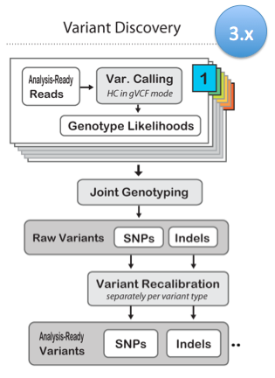
Joint genotyping
Notes:
What joint genotyping and its gVCF format enables is greater scalability.
First you call variants individually on each sample using the HaplotypeCaller in -ERC GVCF mode, to produce a record of genotype likelihoods for each site in the genome .
This can then be used in joint genotyping analysis of the gVCFs produced for all samples in a cohort. If samples are added to this cohort then we don’t need to call all the samples together again, we just need to call the new ones and include them in a new joint genotyping.
To summarize, this allows us to achieve the same results as joint calling in terms of accurate genotyping results, without bad runtimes, and with the added flexibility of being able to re-run the population-level genotyping analysis at any time as the available cohort grows.

Slide 51
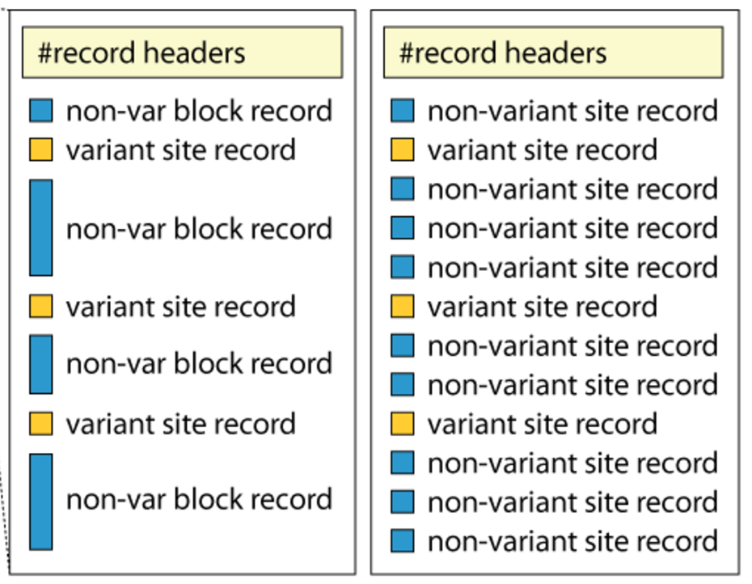
gVCF Files
gVCF
##GVCFBlock=minGQ=0(inclusive),maxGQ=5(exclusive)
##GVCFBlock=minGQ=20(inclusive),maxGQ=60(exclusive)
##GVCFBlock=minGQ=5(inclusive),maxGQ=20(exclusive)
Notes:
For joint genotyping projects we use a different kind of VCF file.
A gVCF file has the same format as a VCF file but it has information for all sites, not just variants. There are two kinds of gVCF files, the older ones had individual records for each site but this is space inefficient.
The new ones have individual variant records for variant sites, but the non-variant sites are grouped together into non-variant block records that represent intervals of sites for which the genotype quality (GQ) is within a certain range or band.
http://gatkforums.broadinstitute.org/wdl/discussion/4017/what-is-a-gvcf-and-how-is-it-different-from-a-regular-vcf
In the so-called GVCF mode used for scalable variant calling in DNA sequence data, HaplotypeCaller runs per-sample to generate an intermediate genomic gVCF (gVCF), which can then be used for joint genotyping of multiple samples in a very efficient way, which enables rapid incremental processing of samples as they roll off the sequencer, as well as scaling to very large cohort sizes (e.g. the 92K exomes of ExAC).

Slide 52
Filtering
module load GATK
#CHROM POS ID REF ALT QUAL FILTER INFO FORMAT
20 14370 rs6054257 G A 29 PASS NS=3;DP=14;AF=0.5;DB;H2 GT:GQ:DP:HQ
VariantFiltration
--filterExpression ”QUAL > 30”
--filterName QUAL_filter
--filterExpression "QUAL / DP < 10.0"
--filterName QUALDP_filter
Notes:
By comparing with existing annotation for the reference genome it is possible to add information about your variants and their effect.
Three commonly used tools for this are annovar, snpeff and vep, or variant effect predictor.
Looking back at one of our variants from the VCF file it really is taking this position on this chromosome and saying “what do we know about this position?”. One annotation has already been added to it, as you can see this variant exists in dbSNP. The input very often to these programs is a VCF file.
It can generally be divided into three groups;
Gene based annotations which look at the functional impact like if the variant can cause protein coding changes. Big changes can be turning a gene off for example.
Region based annotations, like the name implies, identifies any variants in specific regions such as … add any region you want!
Filter based annotations identifies if the variants are documented in specific databases, for example, whether a variant is reported in dbSNP, what is the allele frequency in the 1000 Genome Project, is it connected to Cancer in the COSMIC, or catalogue of somatic mutations in cancer, database, the recently released Swegen allelefrequencies?

Slide 53
Annotation
module load annovar /snpEff / vep
#CHROM POS ID REF ALT QUAL
20 14370 rs6054257 G A 29
Gene-based
Non-synonymous/synonymous
Region-based
CpG-islands
Conserved regions
Predicted transcription factor binding sites
Filter-based
dbSNP
1000G
COSMIC

Slide 54
Annotation
module load annovar /snpEff / vep
#CHROM POS ID REF ALT QUAL
20 14370 rs6054257 G A 29
Gene-based
Non-synonymous/synonymous
Region-based
CpG-islands
Conserved regions
Predicted transcription factor binding sites
Filter-based
dbSNP
1000G
COSMIC
USE THE SAME REFERENCE!

Slide 55
File naming conventions
QC and trimming
Alignment
Local Realignment
Duplicate removal
Variant calling
BQSR
Use informative file names
create a new output file in each process
Include description of process in output file name
Notes:
In order to keep track of all the processes you will run during the exercise it is important to organize your data.
Use good file names. For example “sample.fastq”.
In each analysis step you define an input file and an output file. ALWAYS create a new output file, i.e. do not overwrite the input file.
It is a good practice to include the name of the analysis step (or shortened namethe output file name.

Slide 56
File naming conventions
QC and trimming
Alignment
Local Realignment
Duplicate removal
Variant calling
BQSR
Sample.trimmed.fastq
Sample.bam
Sample.realigned.bam
Sample.dedup.bam
Sample.vcf
Sample.bqsr.bam

Slide 57
Indices
Most large files we work with need an index
Different index for different file-types
Bwa index creates one set of index for the reference that it needs for performing alignment
Other programs like samtools produce other types of index for .fasta and .bam files needed by other programs

Slide 58
Flowchart of lab
Index reference genome
Sample1: NA06984
Sample2
Sample3
read1.fq
read2.fq
read1.fq
read2.fq
mapping
Bwa mem
Bwa mem
AddOrReplaceReadGroups
AddOrReplaceReadGroups
BuildBamIndex
BuildBamIndex
RealignerTargetCreator
RealignerTargetCreator
processing
IndelRealigner
IndelRealigner
MarkDuplicates
MarkDuplicates
BuildBamIndex
BuildBamIndex
BaseRecalibrator
BaseRecalibrator
PrintReads
PrintReads
NA00097.realign.dedup.recal.bam
Sample2.realign.dedup.recal.bam
Variant calling
HaplotypeCaller
HaplotypeCaller
NA00097.g.vcf
Sample2.g.vcf
Sample3.g.vcf
Joint variant calling
GenotypeGVCFs
AllSamples.vcf
Variant filtration
VariantFiltration
AllSamples.filtered.vcf
View in IGV

Slide 59
Questions?
Notes:
Thank you and questions?
The exercises, can be reached as usual through the schedule for the course.

Slide 60
Questions?
Work like a professional bioinformatician – Google errors!
Notes:
Thank you and questions?
The exercises, can be reached as usual through the schedule for the course.

